Slide 1
A direct measure of entrainment
David M. Romps
Workshop on Large-Scale Circulations
in Moist Convecting Atmospheres
October 17, 2009

Slide 2
Conclusion
The bulk-plume equations, when used to diagnose large-eddy simulations, underestimate convective entrainment.
Implication
Too little entrainment
→ Too little sensitivity to mid-tropospheric moisture
→ Muted convectively coupled waves
Way forward
Design an independent way to diagnose entrainment
and use that rate in convective parameterizations.

Slide 3
Entrainment into what?
We need an algorithm for classifying the atmosphere into two categories:
active & inactive
Define the “activity operator”, , such that
Example:
We can now define entrainment and detrainment in terms of :
An air parcel entrains when it flips from inactive to active
An air parcel detrains when it flips from active to inactive

Slide 4
Standard bulk-plume diagnosis of entrainment

Slide 5
Standard bulk-plume diagnosis of entrainment
Bulk-plume equations
Consider the case of = total water.....
Bulk-plume approximation:

Slide 6
Problems with the bulk-plume diagnosis of entrainment
The bulk-plume equations:
Underestimate entrainment

Slide 7
Model setup
LES of shallow convection
LES of deep convection
12.8 km
25.6 km
RRTM
Lin-Lord-Krueger
w/o precip
3 km
25.6 km
Lin-Lord-Krueger
6-class microphysics
50-meter
grid cells
200-meter
grid cells
12.8 km
25.6 km
SST = 300.4 K
300-K SST
DAM
(Romps, “The dry-entropy budget of a moist atmosphere”, JAS, 2008)

Slide 8
Problems with the bulk-plume diagnosis of entrainment
The bulk-plume equations:
Underestimate entrainment
Produce tracer-dependent estimates of entrainment
Produce unphysical values of entrainment

Slide 9
Direct measurement of entrainment
Entrainment is the local source of active fluid
Detrainment is the local sink of active fluid

Slide 10
Direct measurement of entrainment

Slide 11
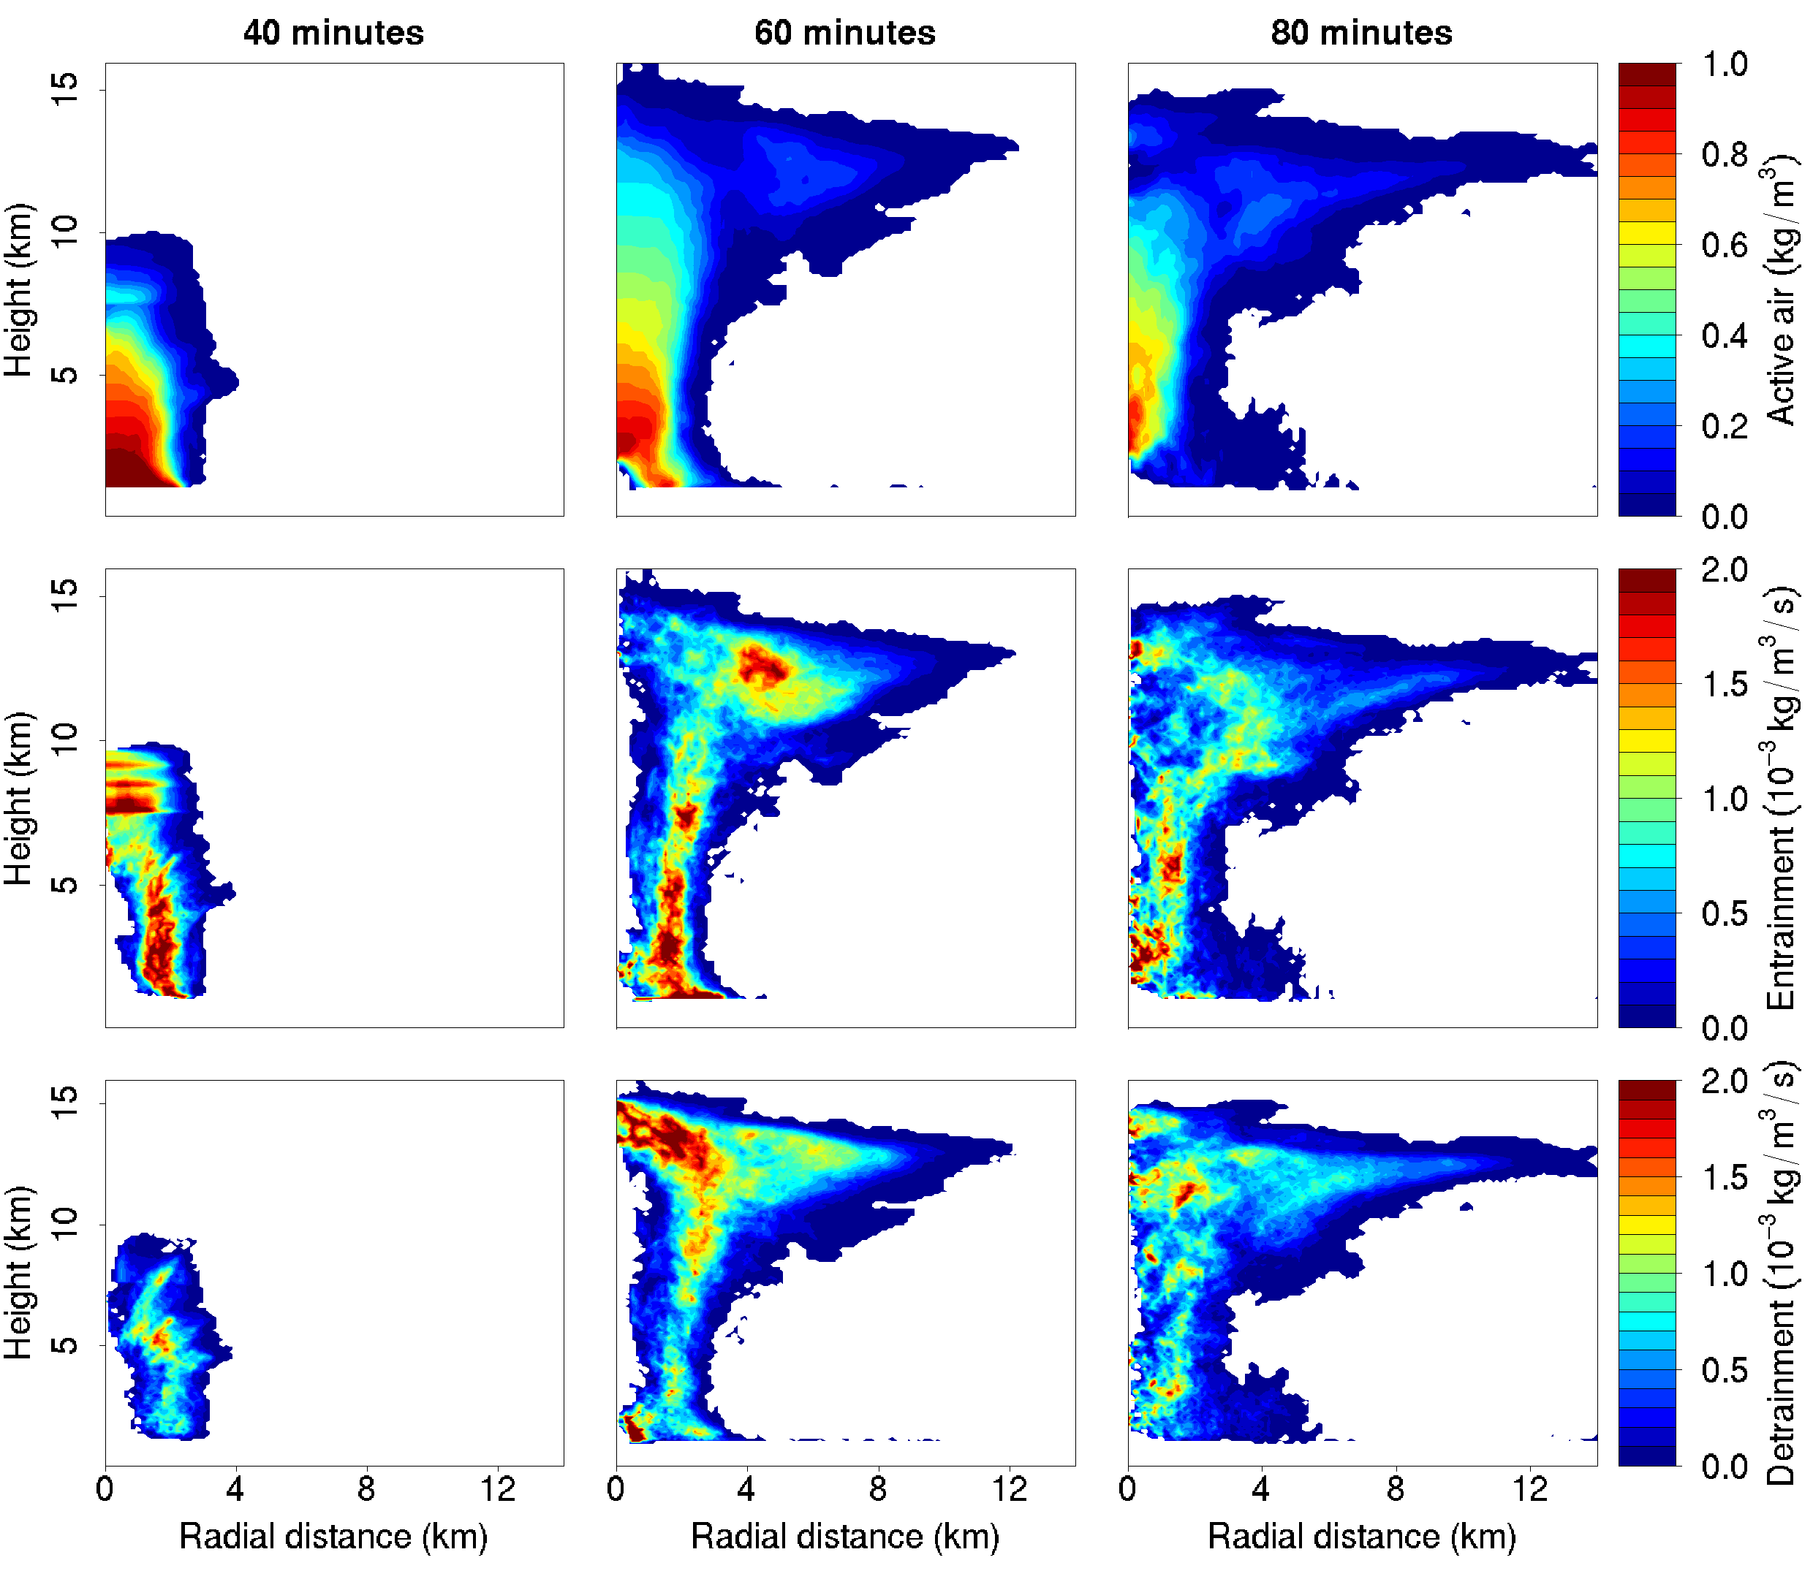
Direct measurement of entrainment
40 minutes
60 minutes
80 minutes
Active air
Entrainment
Detrainment

Slide 12
Direct measurement vs. Bulk-plume equations
Bulk-plume equations
Direct measurement

Slide 13
Direct measurement vs. Bulk-plume equations
Bulk-plume equations underestimate entrainment by roughly a factor of 2
Fractional entrainment does not go like 1/z.

Slide 14
Entrainment-buoyancy relationships
Some relationship:
No relationship:

Slide 15
Boom and bust cycle at the melting line

Slide 16
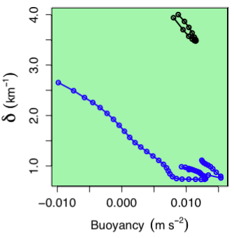
Other conclusions
Standard method produces tracer-dependent and unphysical estimates of entrainment
Direct measurement offers new diagnostic possibilities
Standard method underestimates entrainment by roughly a factor of 2
There is a linear relationship between buoyancy and detrainment

Slide 17
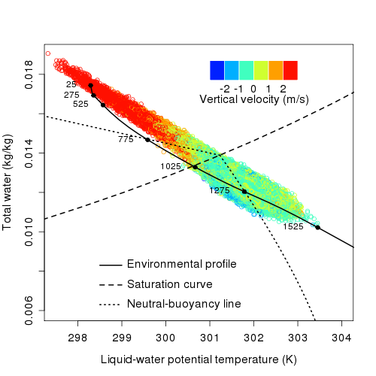
Must understand cloud variance to understand sensitivity to humidity
From LES of BOMEX, we learn that the variability of total water in shallow, non-precipitating clouds is large.
This source of this variability is not cloud-base variability, but, instead, is a source of variability intrinsic to all convection: turbulent entrainment.
(Romps and Kuang, “Nature versus nurture in shallow convection,” JAS, in review)

Slide 18
Other conclusion
Entrainment can be measured directly.
Implication
We can learn what sets the entrainment rate
→ Use this to inform our convective parameterizations
→ Improve simple models of convectively coupled waves
Caution
Be wary of bulk-plume parameterizations!

Slide 19
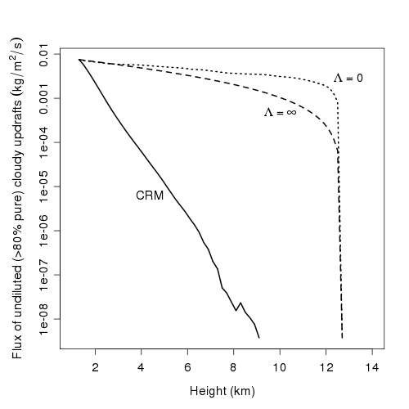
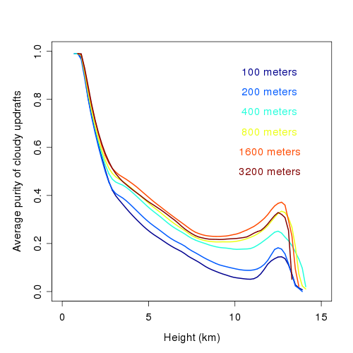
Extend the bulk-plume analysis to deep convection using the purity tracer
In shallow, non-precipitating convection, we can use total water for .
In deep convection, there is no such quantity that is strictly conserved (not even MSE).
Specify “purity” tracer with sources away from convection that maintain:
(Romps and Kuang, “Do undiluted convective plumes exist in the upper tropical troposphere?”, JAS, in press)

Slide 20
Direct measurement of entrainment

Slide 21
Bulk-plume analysis with artificial tracers
In shallow, non-precipitating convection, we can use = total water.
In deep convection, there is no quantity that is strictly conserved (not even MSE).
Define “purity” tracer with sources away from convection that maintain:
Purity tracer

Slide 22
Problems with the bulk-plume diagnosis of entrainment
The bulk-plume equations:
Underestimate entrainment
Produce unphysical values of entrainment

Slide 23
Bulk-plume analysis with artificial tracers
In shallow, non-precipitating convection, we can use = total water.
In deep convection, there is no quantity that is strictly conserved (not even MSE).
Define “purity” tracer with sources away from convection that maintain:
Define “exponential” tracer with sources away from convection that maintain:
Purity tracer
Exponential tracer

